Slide 1
HIGH CLOUD AIRLINES ANALYSIS
Presented by
Group 6

Slide 2
TEAM MEMBER OF THE PROJECT
1.Nivetha
2.Vijesh Y
3.Gana
4.Polepalle Sunil Kumar

Slide 3
Today Agenda
Introduction
Business Overview
Project Scope
Suggestions and Comments

Slide 4
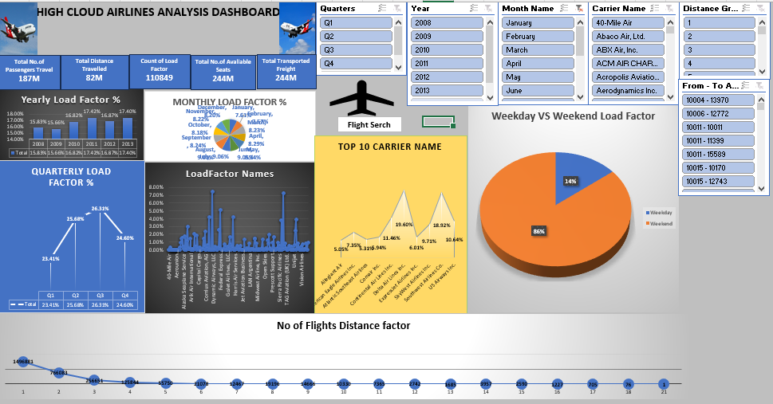
Excel dashboard

Slide 5
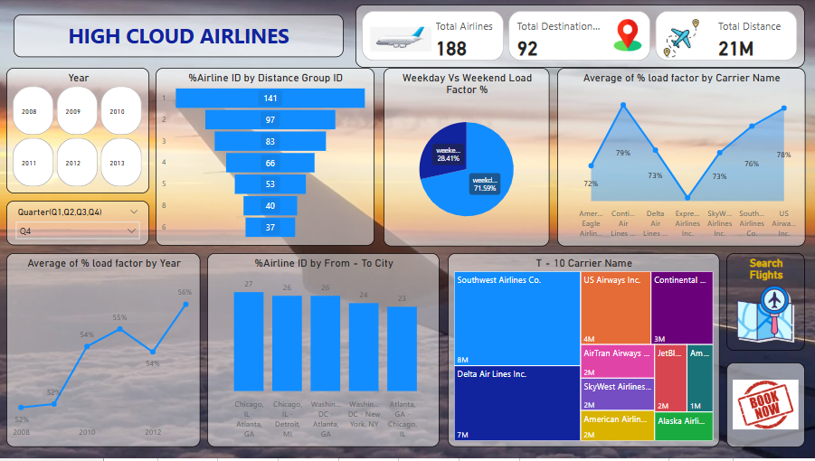
Power bi dashboard

Slide 6
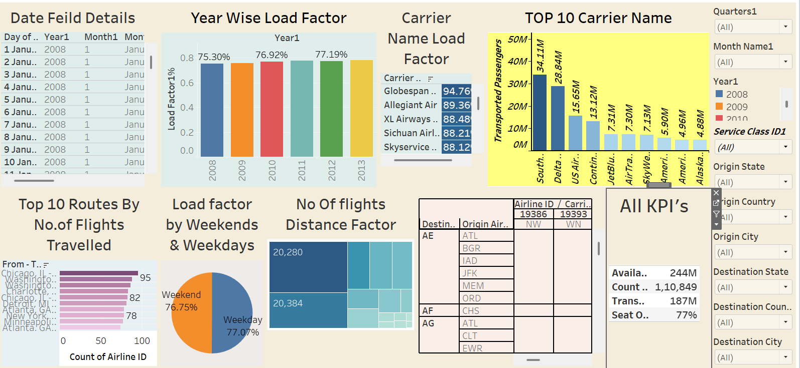
tableau dashboard

Slide 7
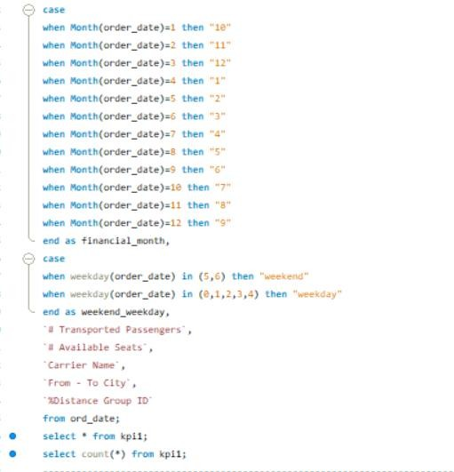
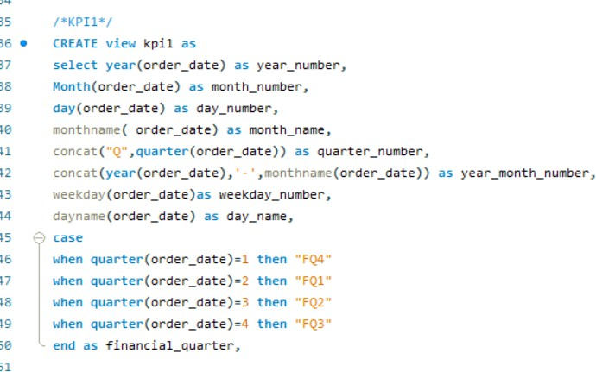
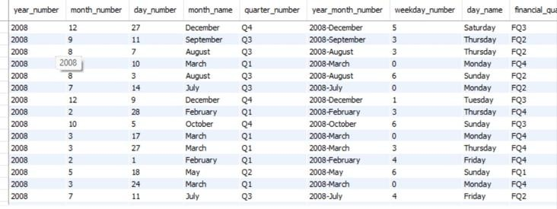
SQL query

Slide 8
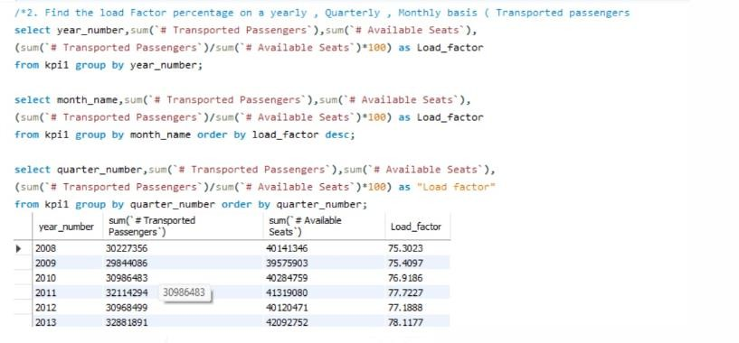
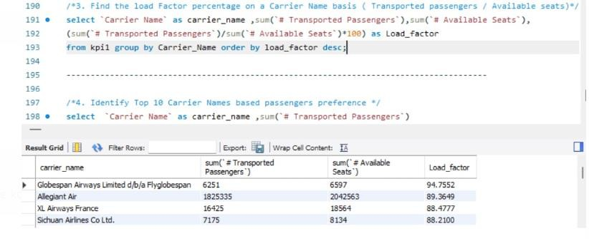

Slide 9
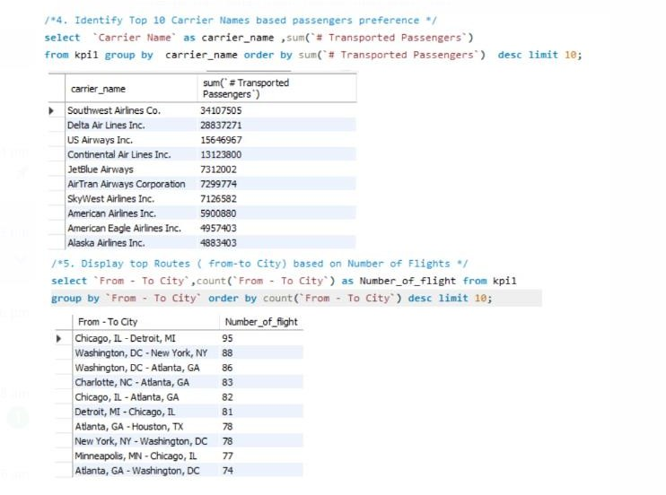

Slide 10
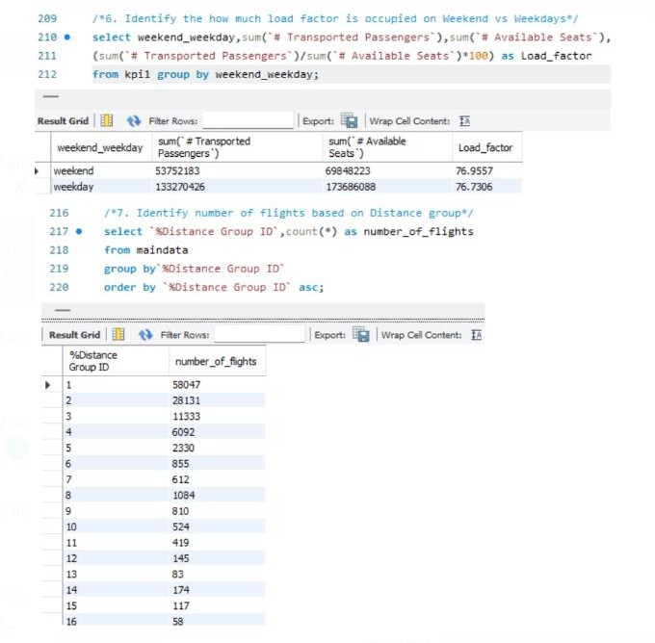

Slide 11
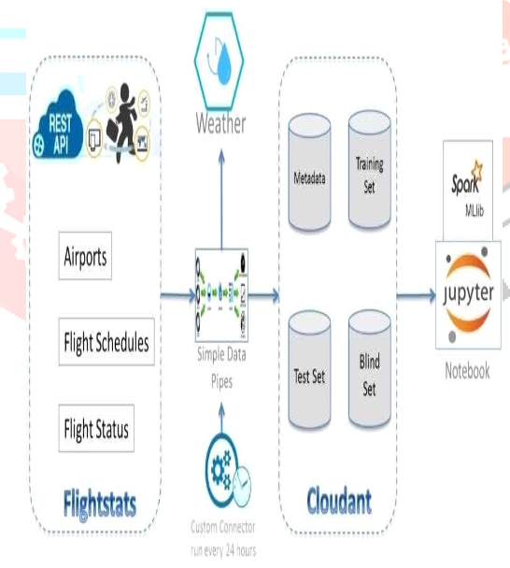
HIGH CLOUD AIRLINES INNOVATION TECHNOLOGY

Slide 12
BUSINESS OVERVIEW HIGH CLOUD AIRLINES
In Today’s competitive airline industry, data analysis plays a critical role in optimizing operations and maximizing profitability. By harnessing the power of data, High Cloud Airlines can give valuable insights into various aspects of its business, allowing them to make data-driven decisions that can lead to.
Improve Load Factor.
Enhanced Passenger Experience.
Find out the reason in 2012 year why the company falls.
Compare to month wise January and February load factor % is less when compare to other month,
so they have to more focus on these month to improve sales.
5. Come to Quarters they have to more focus on Q1 & Q4 because these two quarters they are getting less % when compare to other quarters.
6. Optimized Resource Allocation.
7. CO-ordinating with the Staff & employee for suggestions to improve business.

Slide 13
HIGH CLOUD AIRLINES PROJECT SCOPE
This Project aimed to leverage the power of data analysis and extract valuable insights to optimize High Cloud Airlines operations and performance . The specific scope of the project focused on analyzing key performance indicators (KPIs) to gain a deeper understanding of.
Load Factor
Passenger Feedback
Popular routes
Operational efficiency
Provide Good services to passenger.

Slide 14
TEAM RECOMMENDATIONS
REDUCE TICKET RATES:- to attract weekday’s passenger we have to reduce ticket rates we have to improve weekday’s passenger reduce the ticket rates compare to other Airlines.
Optimize flight Routes: Utilize insights from top routes and flights to optimize schedule and resource allocation.
Strategic Carrier Partnerships: Collaborate with top carriers to maximize passengers transportation and enhance overall performance.
Resource Allocation: Allocate resources strategically based on flight schedules and passengers volume data. This ensures efficient operations and minimizes wait times at airports with high passenger traffic.

Slide 15
CONCLUSION
Allegiant airlines need to focus on there ticket rates and maintain customer relation ship.
High cloud Analysis empowers the aviation industry with actionable insights, fostering efficiency and strategic decision-making.
By harnessing the power of data, we can drive positive changes, ensuring a brighter future for High Cloud Analysis and its partners in the aviation sector.
Need to focus on popular roots.

Slide 16
THANK YOU

